Slide 1
Heliport Airspace Risk Analysis Profile
Discussion Brief on the Potential risk scoring criteria as it pertains to heliport airspace
Updated: January 13,2021

Slide 2
Heliport Airspace Defining Boundaries
Definition of a Heliport’s Imaginary Surfaces found in CFR Part-77
§77.23 Heliport imaginary surfaces.
(a) Primary surface. The area of the primary surface coincides in size and shape with the designated take-off and landing area. This surface is a horizontal plane at the elevation of the established heliport elevation.
(b) Approach surface. The approach surface begins at each end of the heliport primary surface with the same width as the primary surface, and extends outward and upward for a horizontal distance of 4,000 feet where its width is 500 feet. The slope of the approach surface is 8 to 1 for civil heliports and 10 to 1 for military heliports.
(c) Transitional surfaces. These surfaces extend outward and upward from the lateral boundaries of the primary surface and from the approach surfaces at a slope of 2 to 1 for a distance of 250 feet measured horizontally from the centerline of the primary and approach surfaces.

Slide 3
Construction Notice Criteria
§77.9 Construction or alteration requiring notice.
If requested by the FAA, or if you propose any of the following types of construction or alteration, you must file notice with the FAA of:
(3) 25 to 1 for a horizontal distance of 5,000 ft. from the nearest point of the nearest landing and takeoff area of each heliport described in paragraph (d) of this section.

Slide 4
FAA Defined Heliport Obstruction Area
FAA Heliport Design Advisory Circular 150/5390-2C

Slide 5
Recommendations for Lighting & Marking
FAA Heliport Design Advisory Circular 150/5390-2C

Slide 6
Recommendations for Lighting & Marking
FAA Heliport Design Advisory Circular 150/5390-2C

Slide 7
App/Dep Surface & Transitional Surface

Slide 8
Layup of 3 Different Airspaces
Assumption
FATO 105’ X 105’
8:1 App/Dep Surface
Marking & Lighting Surface
400’
500’
Obstruction Reporting Surface
FATO
200’
800’
3,200’
4,000’
5,000’
*Drawing Not To Scale

Slide 9
Risk Area Cross Section
Risk Value = D
8:1 App/Dep Surface
Risk Value = C
Marking & Lighting Surface
Risk Value = B
Obstruction Reporting Surface
Risk Value = A
*Drawing Not To Scale

Slide 10
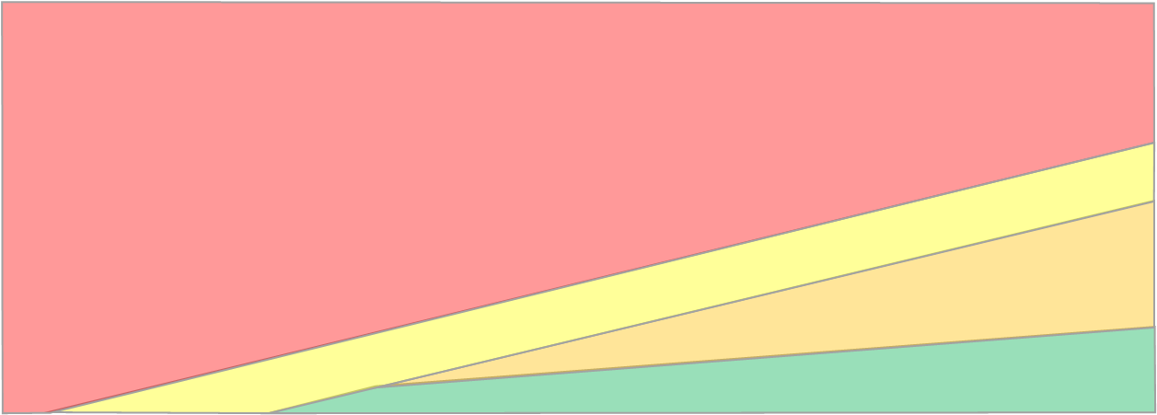
Defined Overall Risk Area
8,105’
*Drawing Not To Scale

Slide 11
Questions
Rex J. Alexander
President, 5^{α}
(260) 494-0891
info@five-alpha.com
If you have questions regarding this information, please contact us.

